Slide 1
Trains Info Case Study
GroupF

Slide 2
Project-1 : Train Information Microservices – Database Schema and Scripts to create necessary tables
DBName : traininquiry
Tables:
Station :
CREATE TABLE `station` (
`id` int NOT NULL, `station_id` int NOT NULL, `station_name` varchar(40) NOT NULL, `arrival_time` varchar(5) NOT NULL, `departure_time` varchar(5) NOT NULL,
`train_id` int NOT NULL, PRIMARY KEY (`id`)) ;
2. Train:
CREATE TABLE `train` ( `train_id` int NOT NULL, `train_name` varchar(40) DEFAULT NULL, PRIMARY KEY (`train_id`)) ;

Slide 3
Project-1 : Train Information Microservices – API Documentation
API Name : STATION-SERVICE-API
Project name : stationinquiry
URI : htttp://localhost:8083/station/api/getByTrainId/{trainId}
Schema:
{ "body":
{ "stations": [
{ "id": 0,
"stationId": 0,
"stationName": "string",
"arrivalTime": "string",
"departureTime": "string",
"trainId": 0
}
]
},
"status": {
"httpStatus": "100 CONTINUE",
"message": "string",
"source": "string"
}
}

Slide 4
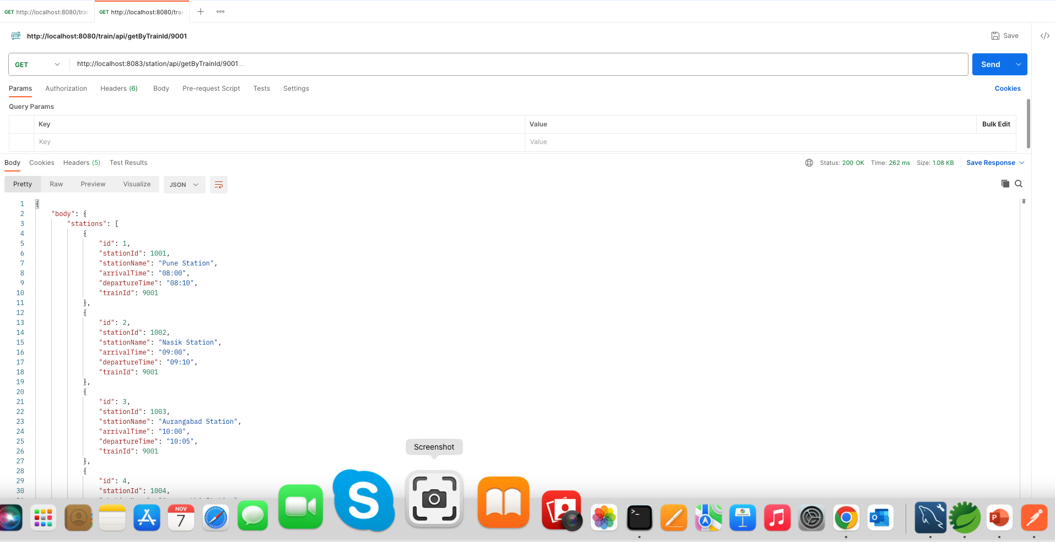
Project-1 : Train Information Microservices – API Documentation
API Name : STATION-SERVICE-API
Project name : stationinquiry
URI : htttp://localhost:8083/station/api/getByTrainId/9001
Sample JSON output from POST-1

Slide 5
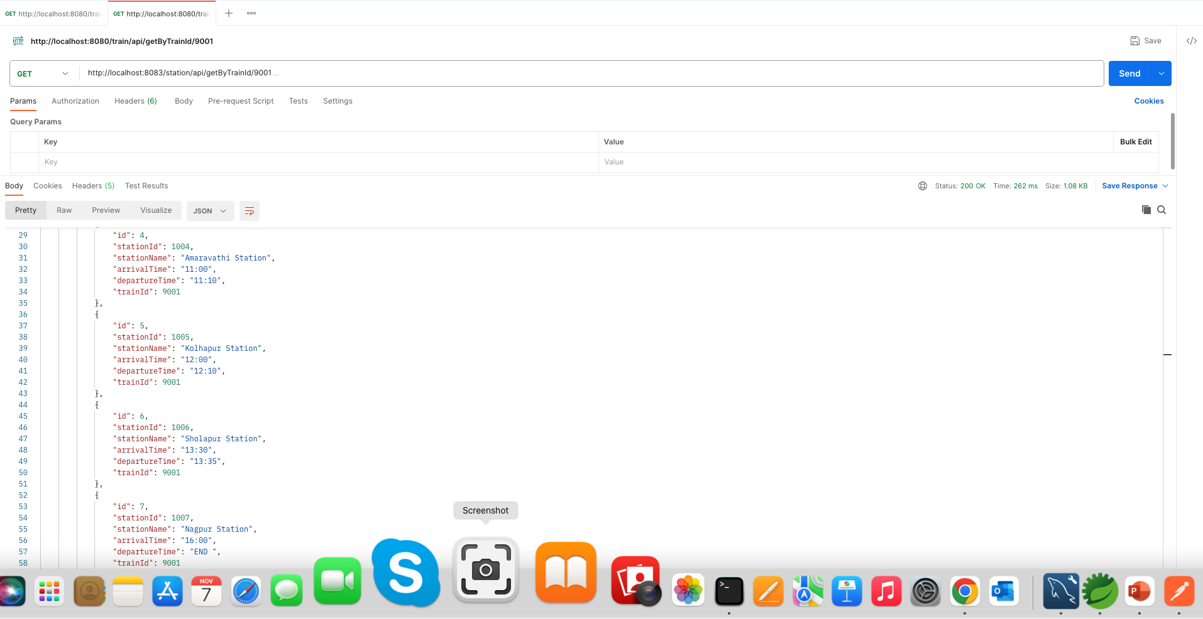
Project-1 : Train Information Microservices – API Documentation
API Name : STATION-SERVICE-API
Project name : stationinquiry
URI : htttp://localhost:8083/station/api/getByTrainId/9001
Sample JSON output from POST-2

Slide 6
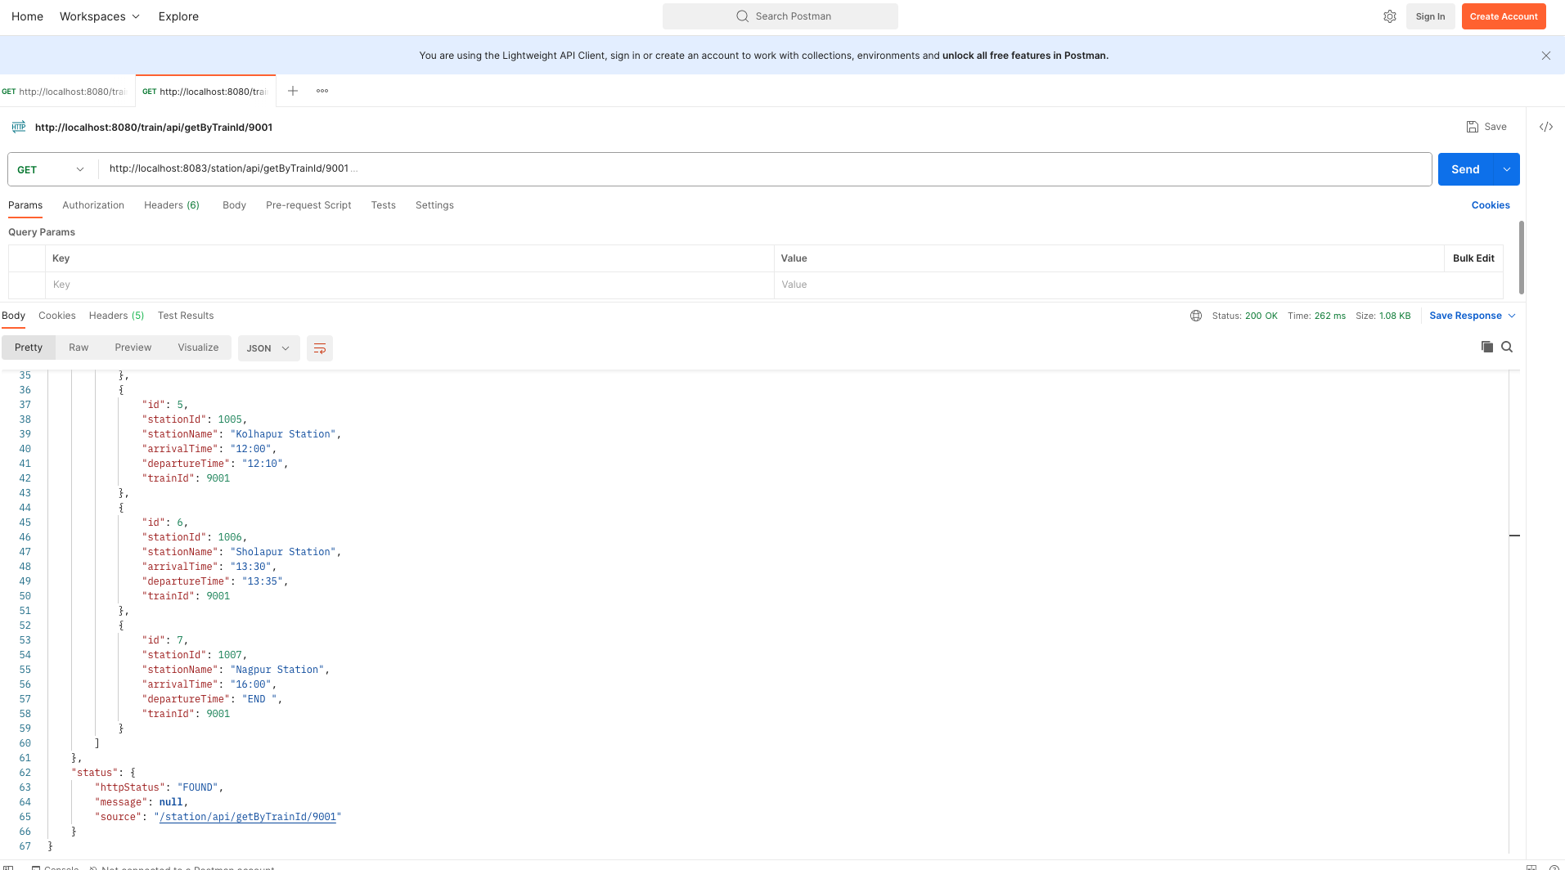
Project-1 : Train Information Microservices – API Documentation
API Name : STATION-SERVICE-API
Project name : stationinquiry
URI : htttp://localhost:8083/station/api/getByTrainId/9001
Sample JSON output from POST-2

Slide 7
Project-1 : Train Information Microservices – API Documentation
API Name : train-service-api
Projectname : trainInquiry
URI : htttp://localhost:8080/train/api/getByTrainId/{trainId}
Schema:
{
"trainResponseBody":
{
"trainId": 0,
"trainName": "string",
"stations": [
{
"id": 0,
"stationId": 0,
"stationName": "string",
"arrivalTime": "string",
"departureTime": "string",
"trainId": 0
}
]
},
"trainResponseStatus": {
"httpStatus": "100 CONTINUE",
"message": "string",
"source": "string”
}
}

Slide 8
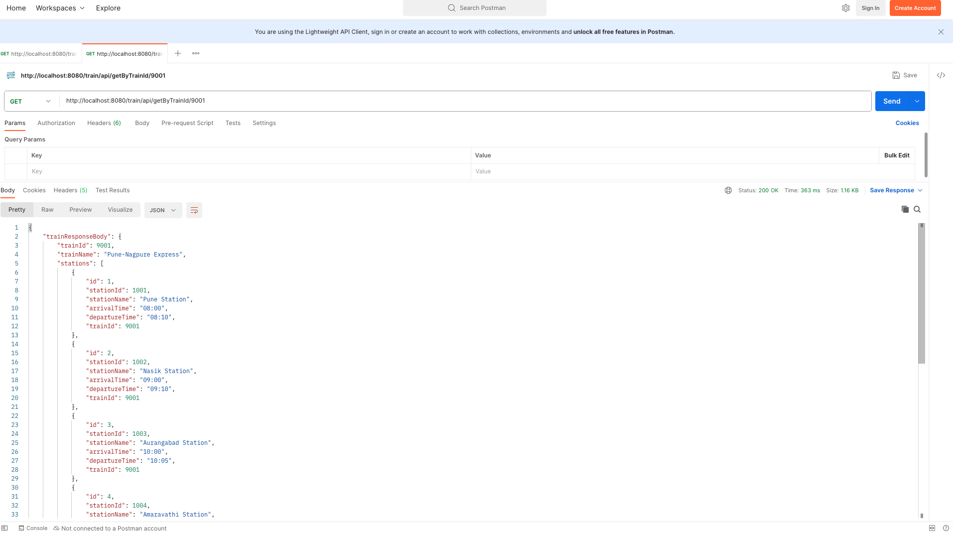
Project-1 : Train Information Microservices – API Documentation
API Name : TRAIN-SERVICE-API
Project name : traininquiry
URI : htttp://localhost:8080/train/api/getByTrainId/9001
Sample JSON output from POST-1

Slide 9
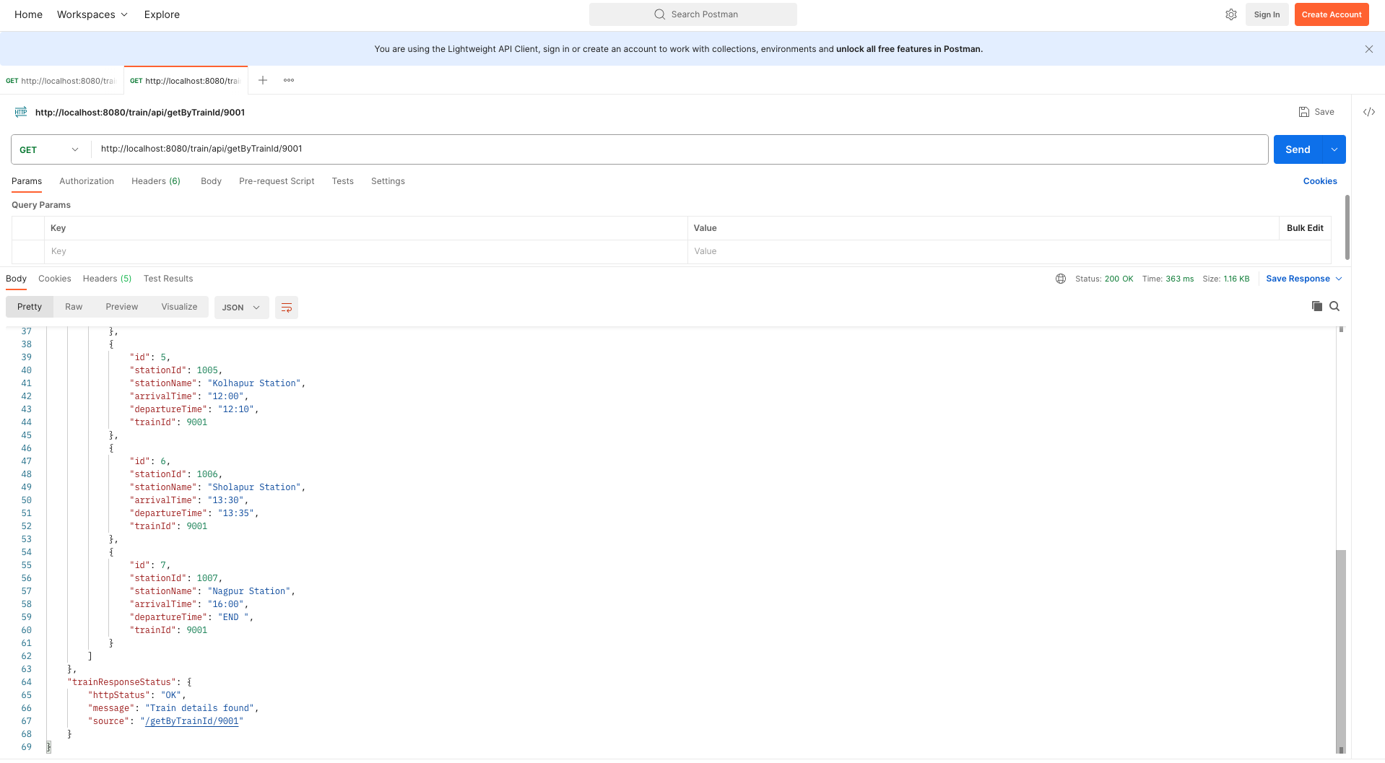
Project-1 : Train Information Microservices – API Documentation
API Name : TRAIN-SERVICE-API
Project name : traininquiry
URI : htttp://localhost:8080/train/api/getByTrainId/9001
Sample JSON output from POST-1

Slide 10
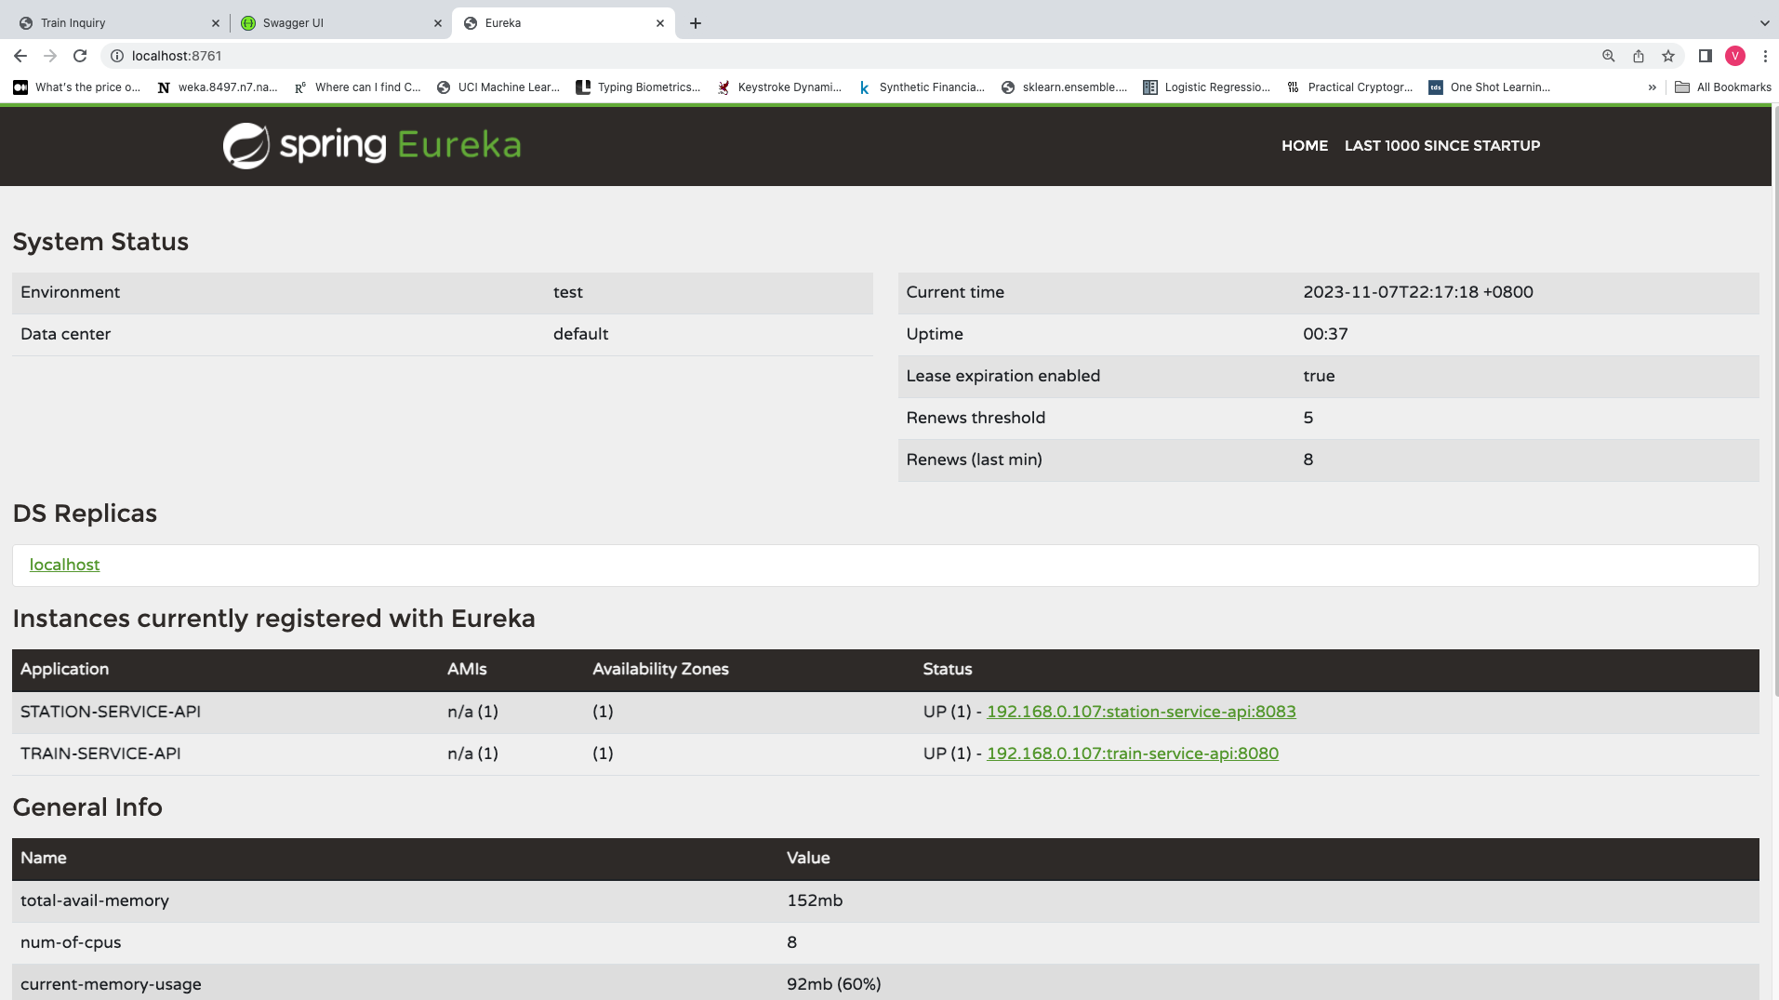
Project-1 : Train Information Microservices – Eureka Service Registry Screen shot

Slide 11
Project-1 : Train Information Microservices – Projects Setup steps
Project names : eureka-server, stationinquiry, traininquiry.
Download the following zip files from Git hub at https://github.com/dhrutimeghana/Groupf-TrainInformation.git
- eureka-server.zip
- stationInquiry.zip
- trainInquiry.zip
Expand the downloaded files to create the folders.
Create projects in Spring Tools Suit by importing these folders in STS.
Create Database schema “traininquiry” in MySQL
Create tables ”station” and “train” using the scripts mentioned in slide 2.
Insert data in the tables and use the URLs mentioned above in POST to display the APIs.

Slide 12
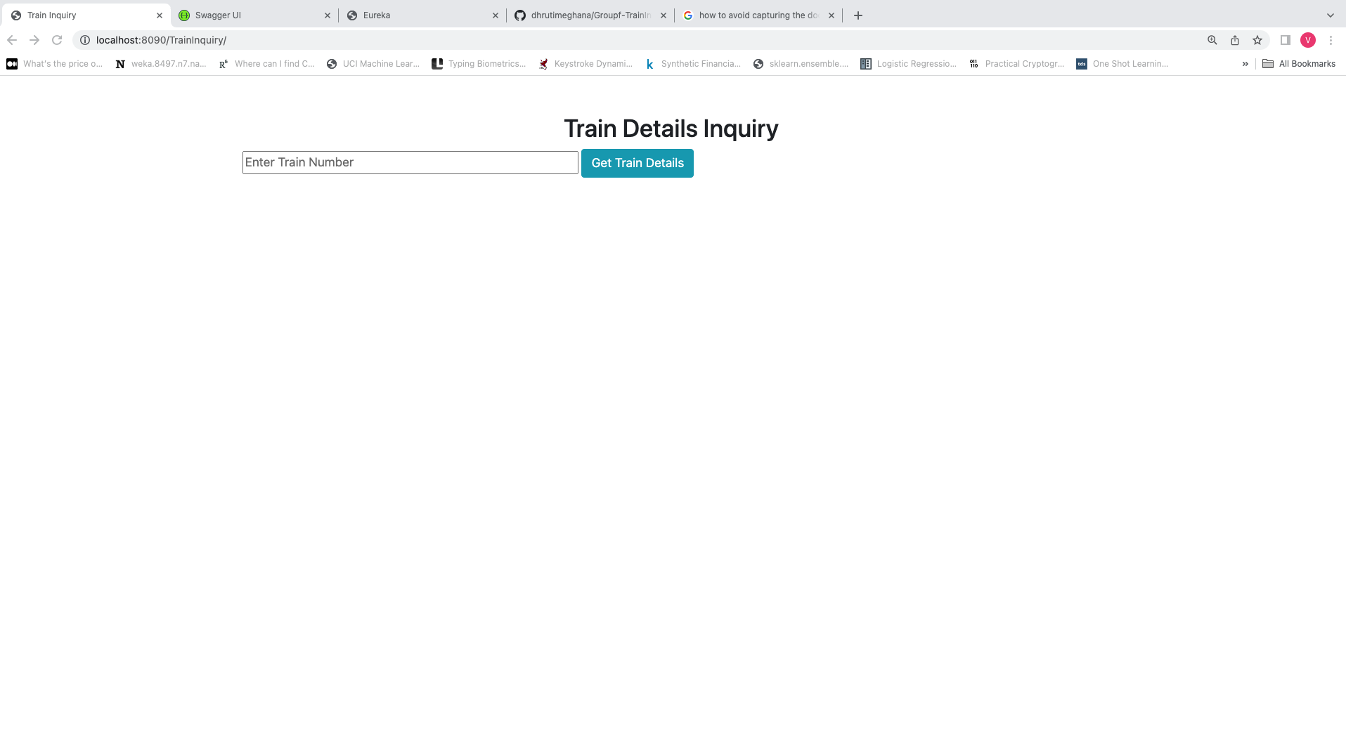
Project-2 : Train Information Consumer
Url : http://localhost:8090/TrainInquiry/

Slide 13
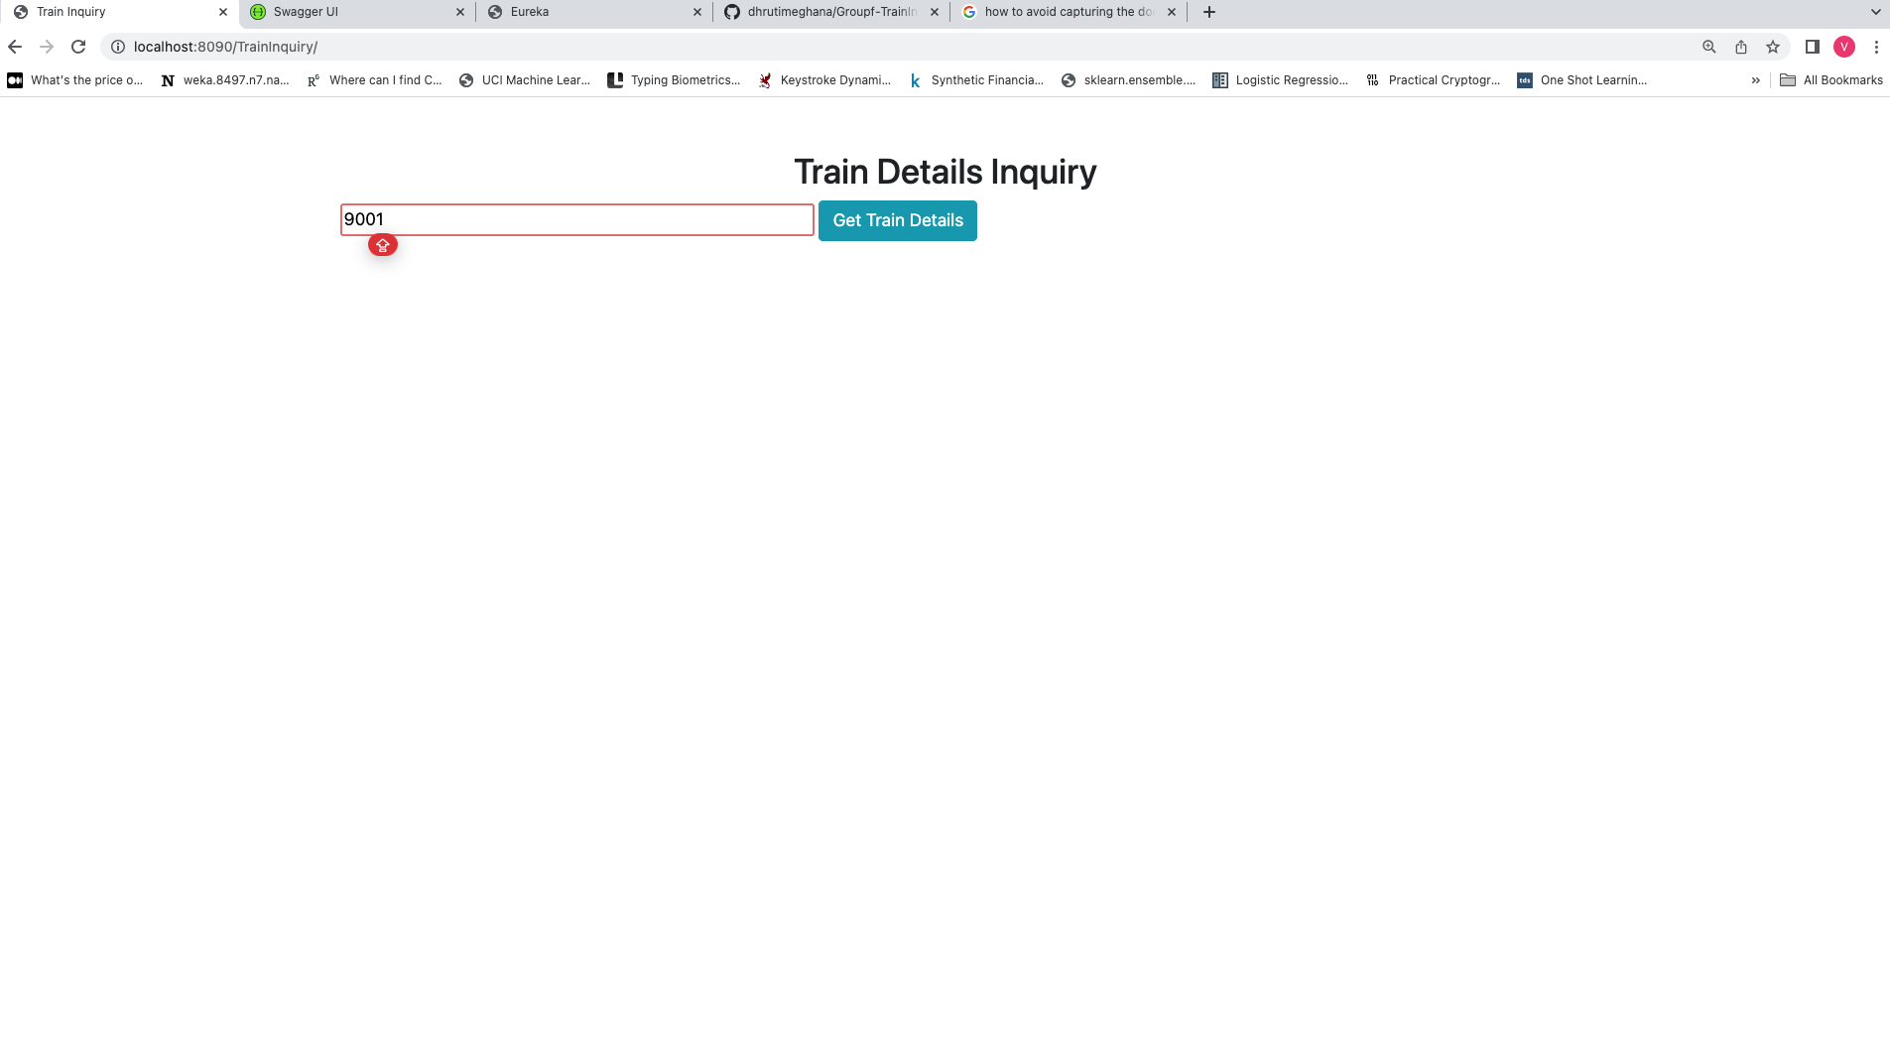
Project-2 : Train Information Consumer
Url : http://localhost:8090/TrainInquiry/

Slide 14
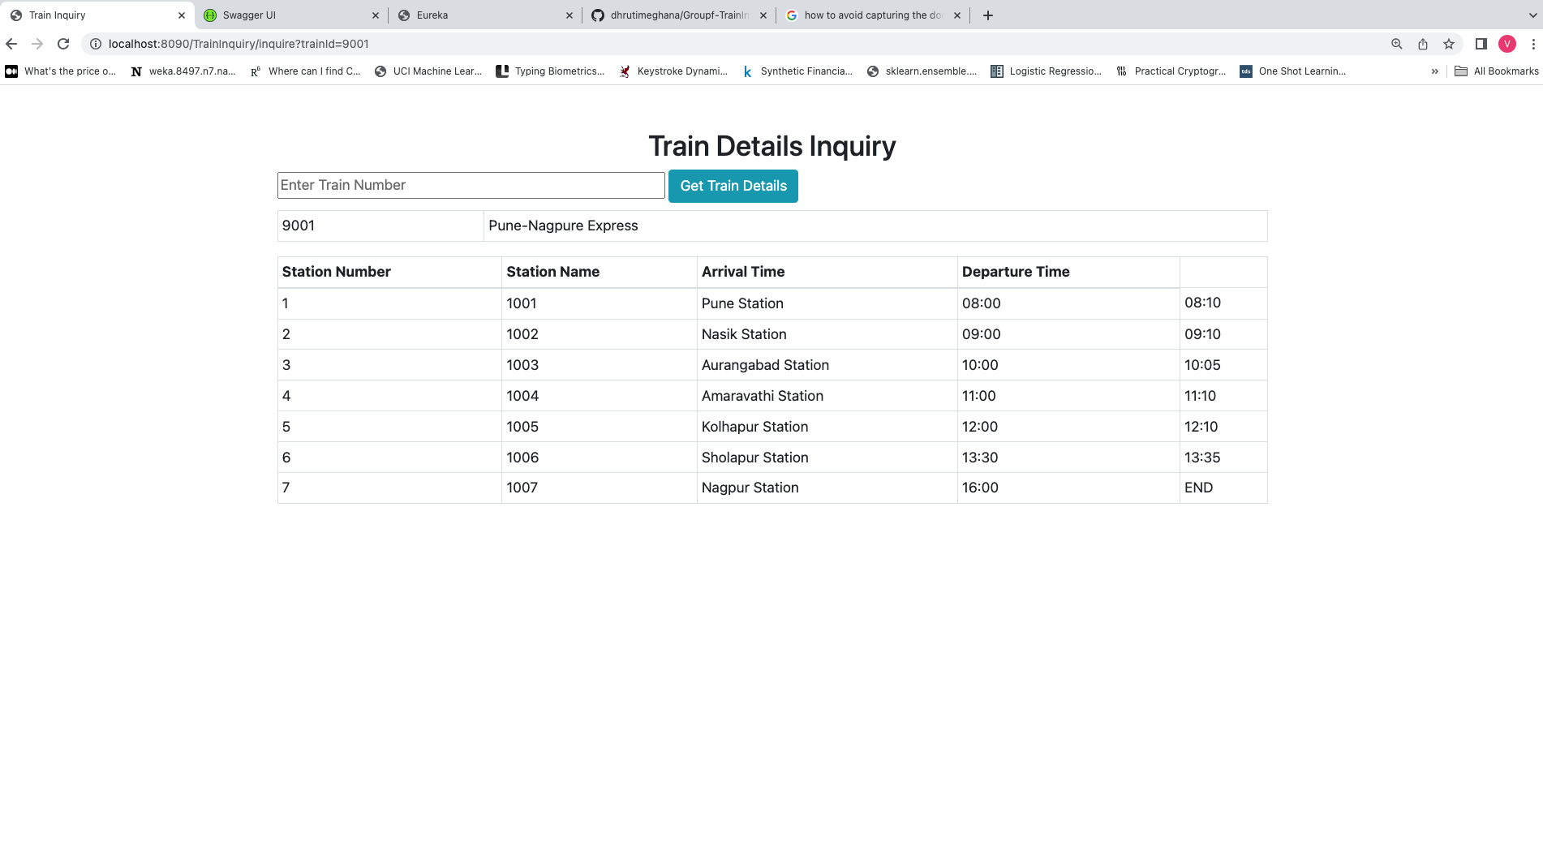
Project-2 : Train Information Consumer
Url : http://localhost:8090/TrainInquiry/

Slide 15
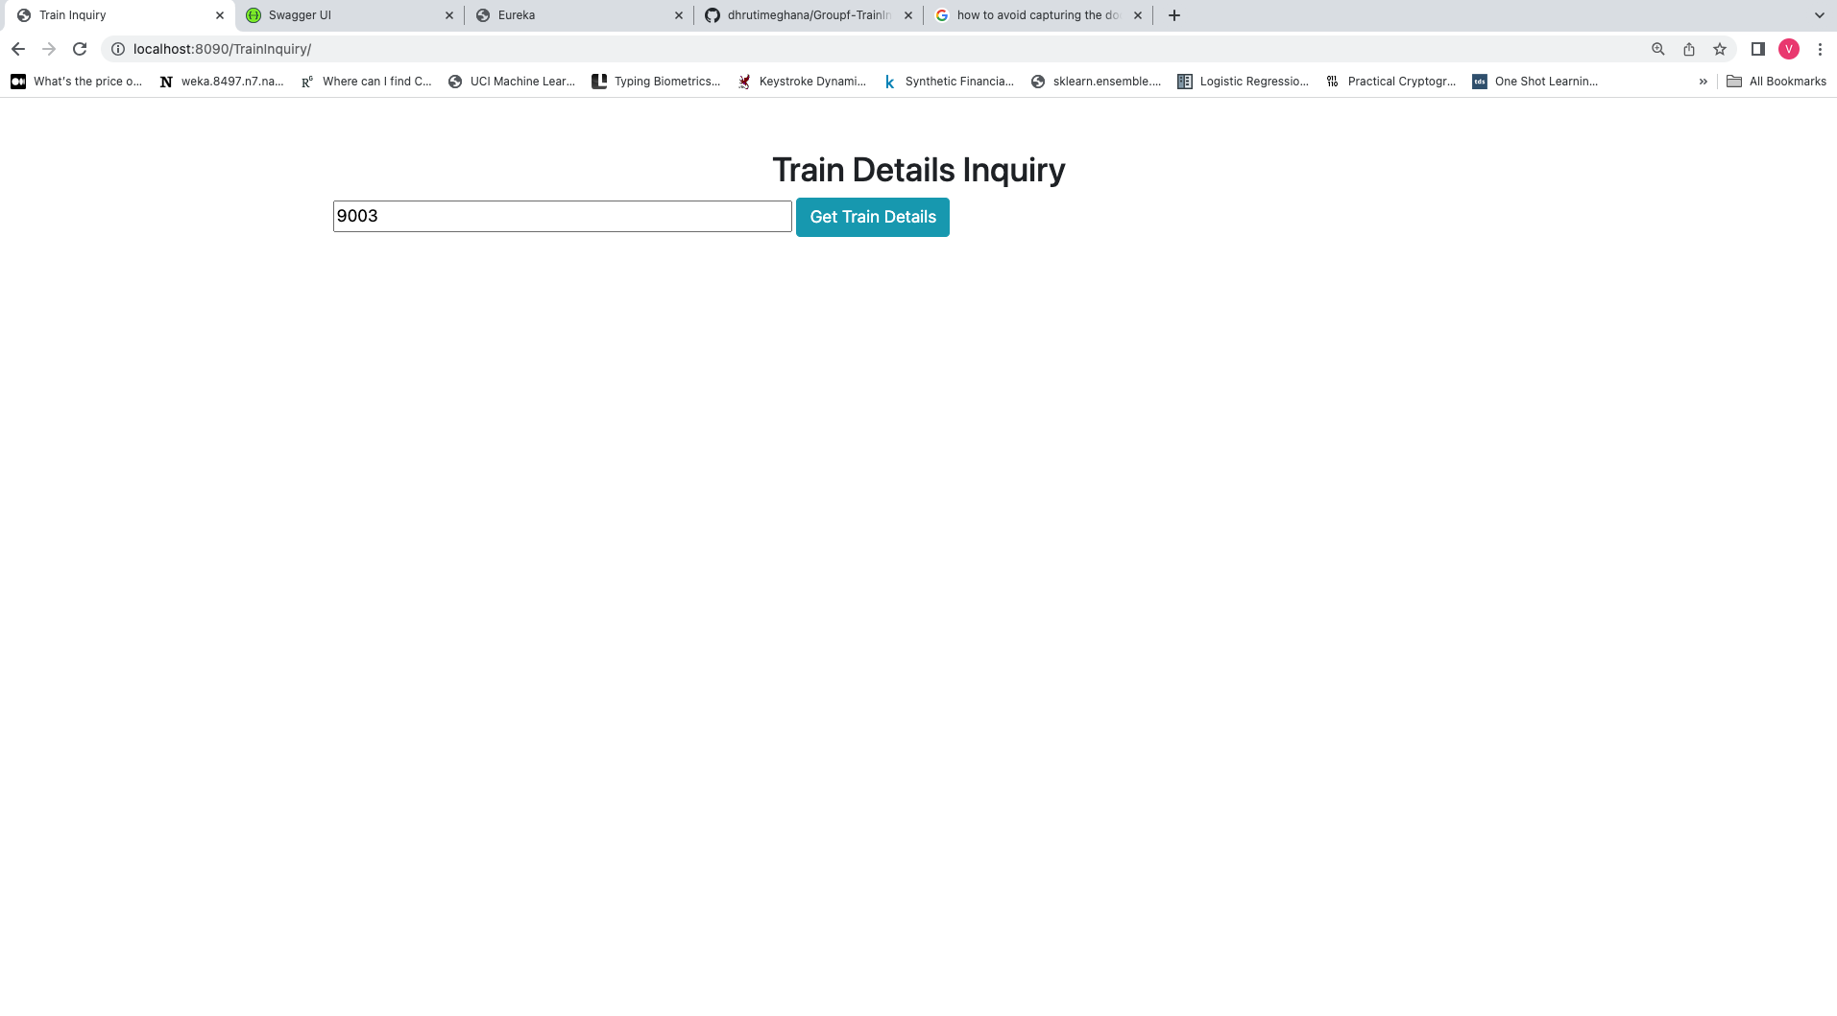
Project-2 : Train Information Consumer – Error Screen
Url : http://localhost:8090/TrainInquiry/

Slide 16
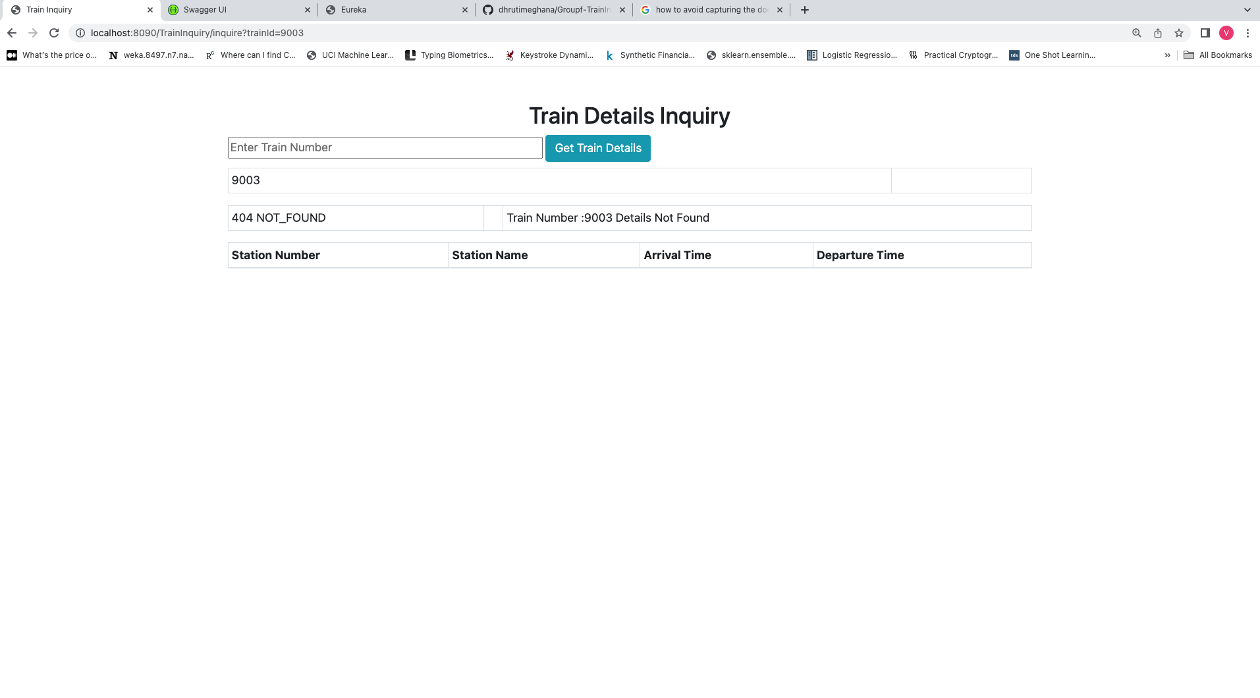
Project-2 : Train Information Consumer – Error Screen
Url : http://localhost:8090/TrainInquiry/

Slide 17
Project-2 : Train Information Consumer– Projects Setup steps
Project names : TrainInquiryApp
Download the following zip files from Git hub at https://github.com/dhrutimeghana/Groupf-TrainInformation.git
- TrainInquiryApp.zip
2. Expand the downloaded files to create the folder.
Create projects in Spring Tools Suit by importing the expanded folder in STS.

